Slide 1
Water

Slide 2
Water
Water is rendered as a grid of triangles
Similar to terrain
We’re really just rendering the “surface”
If you’d like your game to look different when the camera goes under water:
Detect when the camera is below that surface
Draw everything differently (blue tint)

Slide 3
Water grid options
You have two options for the water grid:
Keep it flat
Dynamically alter vertex heights (actual waves)
Keeping it flat has advantages:
Less intensive
Easier to determine when objects are underwater
Can render real-time planar reflections
Dynamic waves advantages:
Looks totally sweet

Slide 4
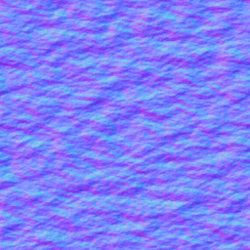
Flat water
A solid-blue grid probably isn’t good enough
But there’s plenty you can do:
Normal maps
Animated/scrolling textures
Animated/scrolling normal maps
Multiple overlapping normal maps
Reflections
Refraction
Dynamic normal-map ripples

Slide 5
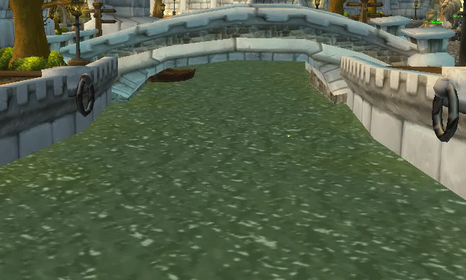
Animated tiling texture
Gives the illusion of the water moving
Low cost, looks decent
Send different textures to the shader over time

Slide 6
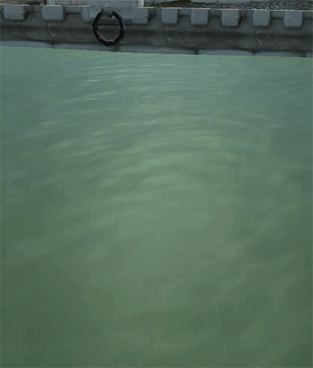
Scrolling normal maps
Use a solid color with scrolling normal maps
Sample the map twice:
Two sets of scrolling UVs
Different directions
Different scales
Average the normals
Dynamic lighting!

Slide 7
Scrolling normal maps - Example
Scroll in slightly different directions
Sample both textures & average normals

Slide 8
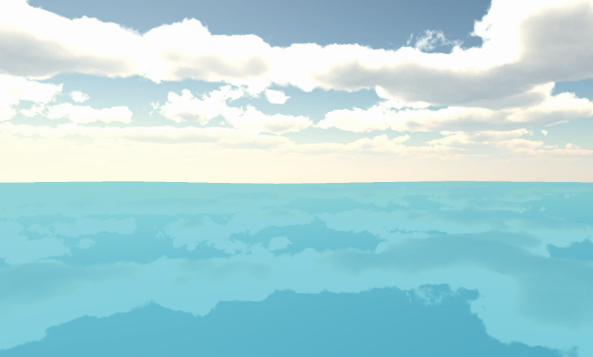
Cube map reflections
Add cube map reflections w/ skybox texture
See the lecture on cube maps for more information

Slide 9
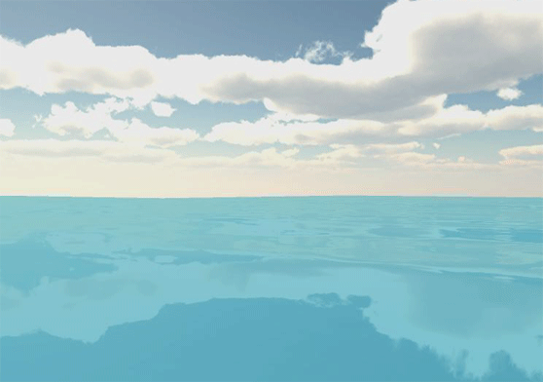
Reflections + scrolling normal maps
Still a flat surface
Makes the water look less static

Slide 10
Planar reflections
One option for real-time reflections
Requires render targets
Also works for mirrors
Render the world “upside down”
Flip upside down across water plane
Render this to a texture to use later
When rendering water, sample reflection texture

Slide 11
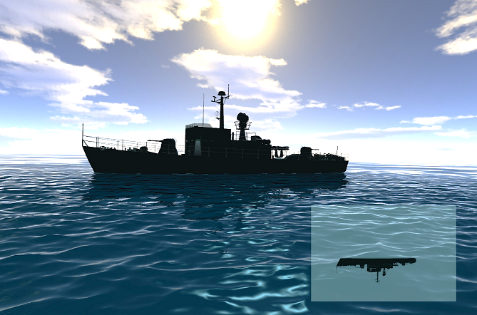
Planar reflection example
Ship reflections (and reflection texture)
Notes:
Image from: http://forum.unity3d.com/threads/triton-oceans-and-3d-water-for-unity-pro-windows-released.151871/

Slide 12
Screen-space reflections
Advanced post-process effect
More on that later
Often combined with cubemap reflections
Uses existing screen colors for reflections
First render entire scene to textures (color & depth)
Without water
When rendering water (for each pixel):
Compute reflection ray bouncing off water
Sample each pixel along that ray
Until you find one where it hits an existing depth

Slide 13
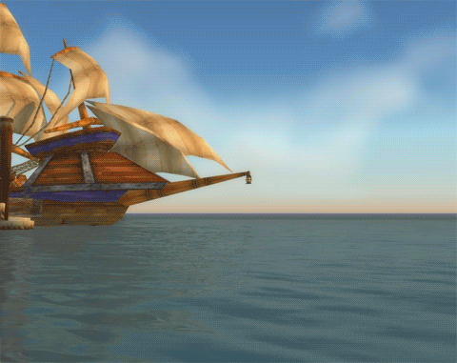
Screen-Space Reflection Example

Slide 14
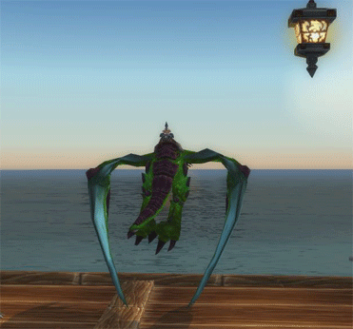
Screen-space reflection - Issues
Character is flying above the dock
But water in the distance is “reflecting” wings

Slide 15
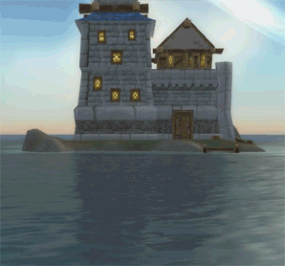
Screen-space reflection - Issues
You need pixels to reflect!

Slide 16
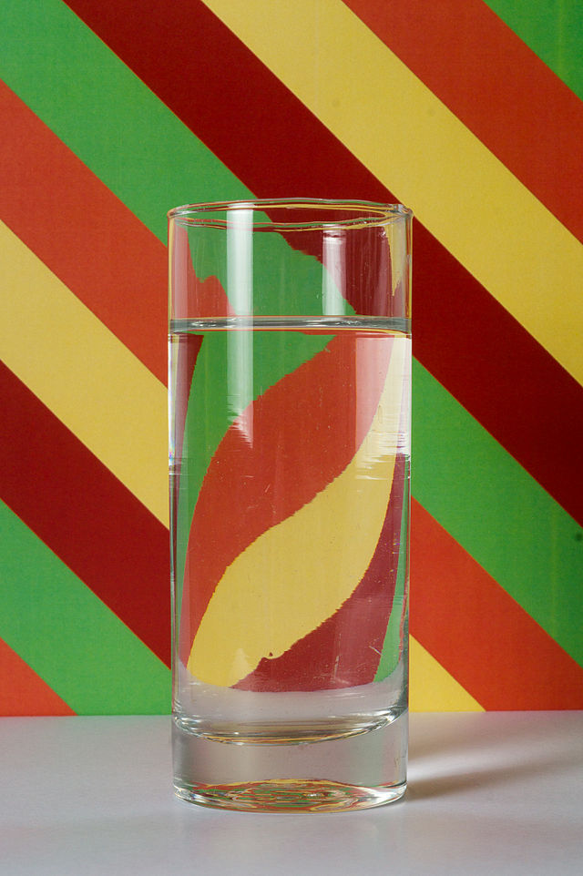
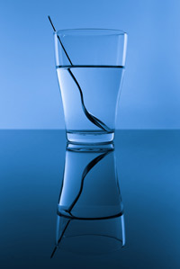
Refraction
A transparent medium may cause light passing through it to bend
Glass, water, etc.
We’re not actually simulating light moving around though
But we sure can fake it!

Slide 17
Rendering refraction
When rendering an object that should refract light, we need to know the pixels behind it
1. Render the entire scene to a texture
Without refractive objects
More on this in the future
2. Render your refractive object
Pass in the “scene texture”
Use the per-pixel normal to alter (perturb) which pixel from the scene texture to use for blending

Slide 18
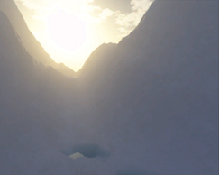
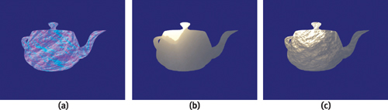
Rendering refraction - Visualization
In this example, a normal map is also applied
Images from GPU Gems 2: Refraction Chapter
Per-pixel normals
Colors already in the scene
Final result

Slide 19
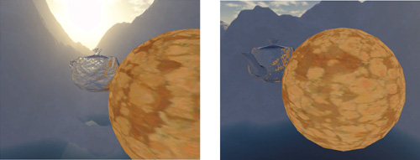
Potential refraction issues
The mesh might “refract” objects in front of it
Looks more like reflection (but isn’t)

Slide 20

Fixing refraction issues
One way is to denote “valid” refraction pixels
Use the alpha channel of scene render texture to denote which pixels can be refracted
Since final alpha value isn’t really used anyway
When sampling scene texture, check the alpha
If it’s invalid, use the non-altered pixel behind the object instead

Slide 21
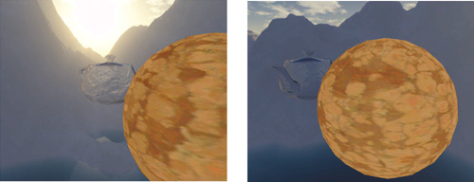
Refraction – Issue vs. Fixed
Only pixels actually behind the object are used
Examples with problems:
Fixed examples:

Slide 22
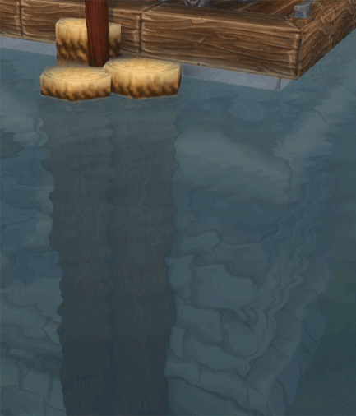
Refraction example

Slide 23
Reflection vs. refraction: Fresnel
Reflection and refraction can both occur
Looking down through water lets you see refraction
Looking across water lets you see more reflection
Fresnel equations describe how light moves between different media
For example: Air and water
A Fresnel term is a value we can use to interpolate between reflection & refraction

Slide 24
Fresnel equation & approximations
Info on Fresnel equations on Wikipedia
Somewhat complex – usually approximated
Schlick’s Approximation
Fresnel term approx = R₀ + (1 - R₀)(1 - cosθ)⁵
R₀ = [(n₁ – n₂) / (n₁ + n₂)]²
n₁ and n₂ are the indices of refraction
Even faster approximation using dot product:
ViewDirection · Normal
Can easily be done in a pixel shader

Slide 25
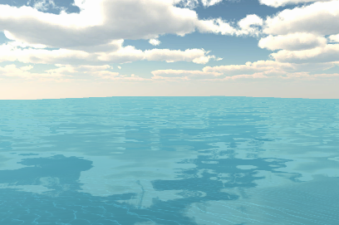
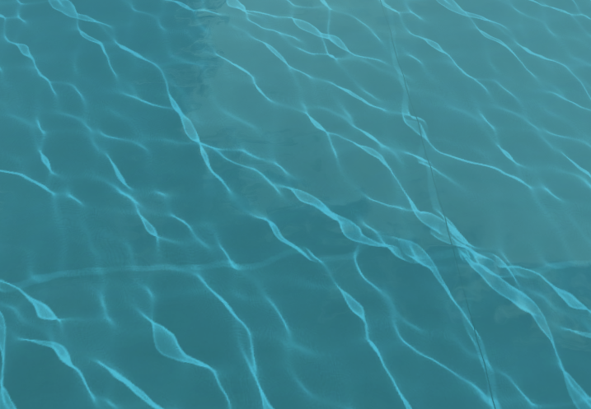
Fresnel term example
Looking across the water
Mostly reflection
Looking through the water
Mostly refraction

Slide 26
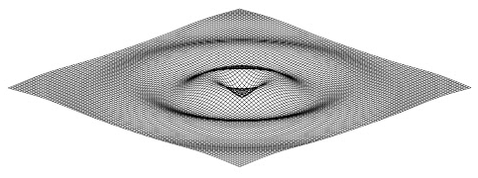
Advanced: Dynamic ripples
A grid of values can simulate 2D ripples
Values of zero mean “at rest”
Positive or negative values move toward zero
Values can “pass” zero and spring back
Values also affect neighboring grid cells
Interactive example at Chrome Experiments

Slide 27
Ripples on the GPU
Ripple grid can be stored in a texture
Textures are just 2D grids of values
But can’t read from and write to the same texture
Ping-pong values between two textures
Render from texture 0 to 1 to update values
Next frame: Render from texture 1 back to 0
Use textures to alter normals of your surface
You can calculate a normal by looking at surrounding pixel heights

Slide 28
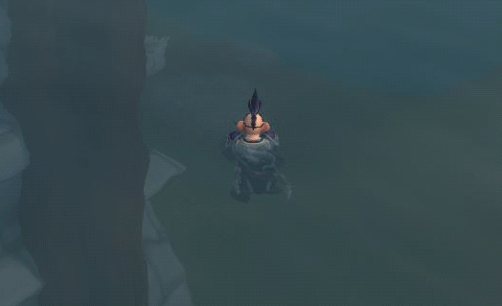
Dynamic ripple example

Slide 29
Non-flat water
In addition to surface effects, you may want to adjust the heights of water grid vertices
This can be accomplished in a few ways:
Displacement mapping
A simple wave-like math function (sin)
Sum of several directional mathematical waves
Previously discussed effects can still be used
Except for planar reflections

Slide 30
Altering water height
Done inside Vertex Shader
Since heights change every frame
Basic implementation just alters Y value
Must also calculate normal for lighting to work!
Remember: Triangles only updated on GPU
If your gameplay depends on waves:
Do same calculations in C++ to determine height
Only needs to be done for objects “on the water”
Not every vertex

Slide 31
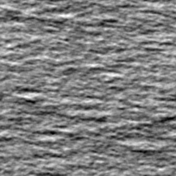
Displacement mapping
Vertices can be moved (displaced) by sampling a texture in the Vertex Shader
Scroll UV coordinates to achieve motion
Scroll multiple displacement maps in different directions to produce complex motion

Slide 32
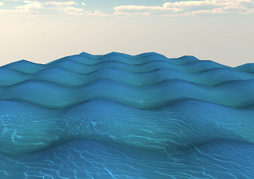
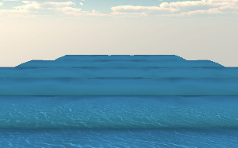
Simple sin waves
Heights could be altered by a simple sin wave
Adjust the sin() parameter based on vertex X and/or Z world positions
Otherwise the entire grid will simply go up & down
Single axis will result in long waves
Both axes will result in water “bumps”

Slide 33
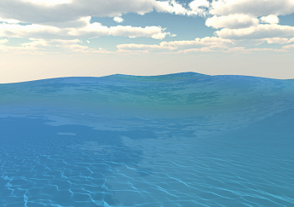
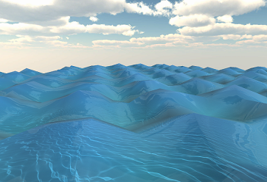
Simple sin wave options
Can customize:
Amplitude
Frequency
Phase
Speed
Make sure options work with your geometry density
Otherwise water might not look smooth

Slide 34
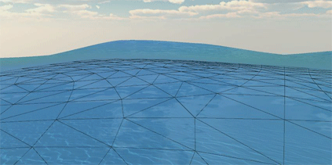
Simple sin wave example

Slide 35
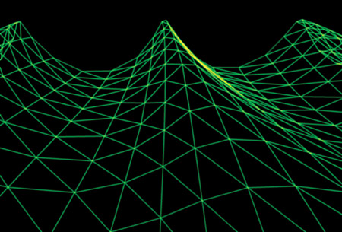
Advanced: Multiple waves
Combine multiple waves
Each moving in a different direction
Results in detailed wave motion
Gerstner waves
Water simulation technique
Also alters X/Z positions
Leads to wave crests
GPU Gems: Water Simulation

Slide 36
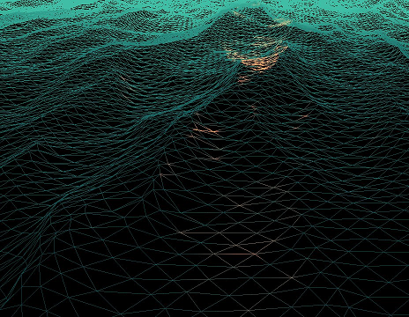
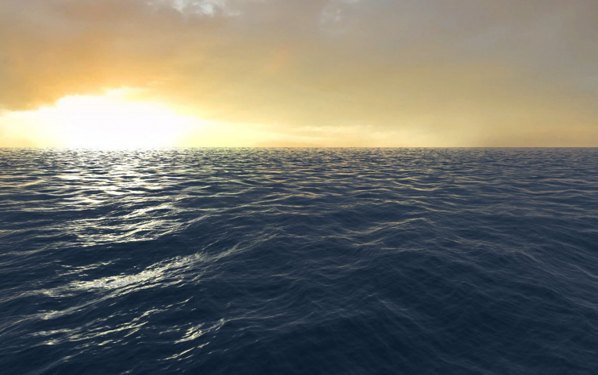
Advanced: FFT Waves
Based on Simulating Ocean Water paper
By Tessendorf
Used in movies and games
Comparison video of FFT vs. Gerstner Waves

